Slide 1
Jazz Swing Era

Slide 2
Swing Era = Big Band Era
Number of instruments in the bands was larger than in Dixie.and.
Common number of instruments in a big band was/is 17.
Most music was written (arranged).
Primarily for dancing.
Call and Response.
2 Alto 2 Tenor 1 Bari
Piano
Bass
Drums
Guitar
4 Tpts 4 Bones

Slide 3
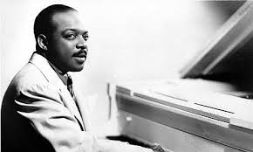
Famous Musicians of Swing
Duke Ellington – pianist
Count Basie - pianist
Benny Goodman - clarinet
1914-1974
Main Stem
Brief Biography
1904-1984
Jumpin' at the Woodside
1909-1986
Sing, Sing, Sing
Brief Biography

Slide 4
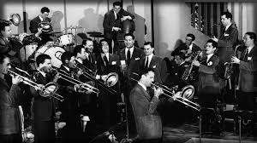
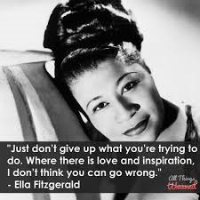
More greats…
Glenn Miller Orchestra
Ella Fitzgerald (First Lady of Song) 1917-1996

Slide 5
Charleston Swing
The Charleston is a dance named after Charleston, Sc
Became popular in 1923.
“The Charleston” by James P. Johnson
Let’s dance!!!

